Slide 1

SHREE CHANAKYA EDUCATION SOCIETY’S
INDIRA COLLEGE OF ENGINEERING AND MANAGEMENT
Approved By AICTE New Delhi, DTE (MS) and An “Autonomous Institute Affiliated to Pune University”
------------------------------------------------------------------------------------------------------------------------------
Academic Year 2025-26
Project Review 1
Guidance.AI: A Smart Application for Project Management
Group Members :
1) Shrinath Khade 3) Prathmesh Tamboli
2) Vijay Kadam 4) Prathmesh Butte
Guided By : Prof.Harshal Mahajan

Slide 2
Agenda
Introduction
Literature Survey
Taxonomy Chart
Problem Statement
Motivation
Objectives
Scope
Proposed System
Conclusion
References

Slide 3
Introduction
In today’s fast-paced world, managing personal finances efficiently is crucial. An AI-powered expense tracker offers a smart solution to monitor and control daily expenditures. The AI expense tracker simplifies financial management by automatically categorizing expenses, detecting patterns, and providing insightful analytics.
Users can easily input their expenses through various methods, including scanning receipts or manually entering data. The AI system then processes this information, ensuring accuracy and reducing the risk of human error.
By offering real-time updates and personalized recommendations, the AI expense tracker empowers users to make informed financial decision. This application is particularly beneficial for individuals seeking to improve and achieve their financial goals.

Slide 4
Literature Survey
Sr. No. | Title of Paper | Year | Author | Key Points | Limitations
1. | A Web-Based Repository for Undergraduate Projects | 2021 | S.I. Bawa, S. U. Olatinwo, A.A. Garba | PHP/MySQL, enables version control and remote access; survey shows high user satisfaction | Requires stable internet; adoption may depend on department-wide training
2. | Web-Based Master Student Project Evaluation and Management System (EVA) | 2022 | Ng K. Song, Juliana Wahid | Structured multi-phase project evaluation process; 40% reduction in staff workload reported | Prototype; tested on a single program and may not generalize to all disciplines
3. | Academic Project Approval System through Online | 2021 | P. Vijayalakshmi, M. Rajalakshmi | End-to-end automation of proposal review, status tracking with multi-role access | Limited customization for diverse project requirements
4. | Project Review Management System | 2023 | Y.Sakpal, A. Gharat | Milestone-based review process, benchmarking, reduction in review cycle time | Limited discussion of security and data privacy

Slide 5


Taxonomy Chart
Parameters Papers | Online Submission | Automated Review Workflow | Multi-Stage Evaluation | Idea Suggession | Plagarism Detection
A Web-Based Repository for Undergraduate Projects
Web-Based Master Student Project Evaluation and Management System (EVA)
Academic Project Approval System through Online
Project Review Management System
Proposed System

Slide 6
Problem Statement
Many people find it difficult to manage their daily expenses and make informed financial decisions. Existing tools often lack the ability to provide detailed insights and personalized advice.
Without a comprehensive system, users struggle to track their spending habits effectively.
This leads to poor financial management and missed opportunities for savings.
Therefore, there is a need for a solution that uses AI to help people understand their expenses, predict future spending, and offer personalized tips to improve their financial health.

Slide 7
Motivation
An expense tracker website is motivated by the growing need for individuals to have better control over their finances. Here are the primary motivations:
1.Financial Awareness: Many people struggle to keep track of their daily expenses, leading to overspending and financial stress. An AI expense tracker can help users gain better control over their finances by providing real time insights and alerts.
2. Automation: Manual tracking of expenses can be tedious and error-prone. Automating this process with AI can save time and reduce errors, making financial management more efficient.
3. Enhanced Budgeting: An AI expense tracker can help users create and stick to a budget by providing detailed insights into their spending habits. This can lead to better financial discipline and long-term savings.

Slide 8
Objectives
The objectives of an AI-powered expense tracker focus on improving personal and business financial management through automation, analytics, and real-time insights, the primary objectives:
Automate Expense Tracking: Develop an AI system that automatically tracks and categorizes daily expenditures, reducing the need for manual input and minimizing errors.
Provide Financial Insights: Offer users detailed insights into their spending habits, helping them understand where their money is going and identify areas for improvement.
Set and Achieve Financial Goals: Enable users to set financial goals and track their progress, offering guidance and motivation to achieve these goals.
Improve Financial Literacy: Educate users about financial management through tips, resources, and interactive tools.

Slide 9
Scope
User Registration and Authentication: Implement a secure user registration and login system, including multi-factor authentication for enhanced security.
Expense Tracking: Develop features for automatic categorization of expenses using AI, with options for manual entry and integration with bank accounts and credit cards.
Financial Insights and Reporting: Create real-time dashboards displaying spending patterns and trends, along with weekly and monthly reports summarizing financial activities.
Monitor Spending vs. Budget: The app tracks spending against budget limits and sends notifications when budgets are exceeded.

Slide 10
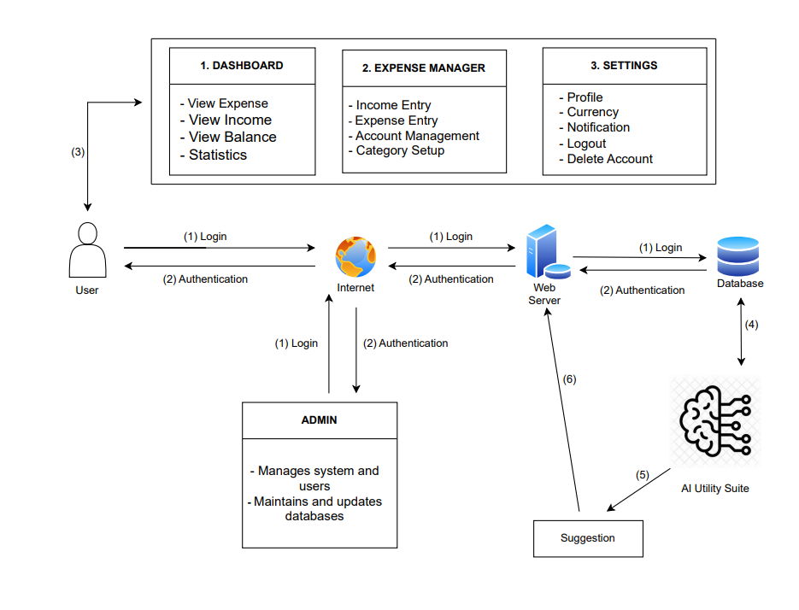
Proposed System

Slide 11
Conclusion
The AI Expense Tracker project aims to revolutionize personal finance management by leveraging advanced AI and machine learning technologies.
By automating expense tracking, providing real time financial insights, and offering personalized budgeting tools, this project addresses the common challenges individuals face in managing their finances.
The integration of technology, particularly AI and machine learning, has significantly enhanced the capabilities of expense trackers, enabling features like automated categorization, predictive analytics, and personalized financial advice.
As technology continues to evolve, we can expect expense trackers to become even more sophisticated and indispensable in our financial lives.
Ultimately, the success of an expense tracker lies in its ability to simplify the budgeting process, provide actionable insights, and promote financial discipline.

Slide 12
References
Bawa, S.I., Olatinwo, S.U., & Garba, A.A. (2021). A Web-Based Repository for Undergraduate Projects. Available at: ProjectList
Song, N.K., & Wahid, J. (2022). Web-Based Master Student Project Evaluation and Management System (EVA). Multidisciplinary Applied Research and Innovation, 3(4), 88-97. Available at: UTHM Publisher
Vijayalakshmi, P., & Rajalakshmi, M. (2021). Academic Project Approval System through Online. International Journal of Advanced Research in Computer and Communication Engineering. Available at: IJARCCE PDF
Sakpal, Y., & Gharat, A. (2023). Project Review Management System. International Research Journal of Engineering and Technology. Available at: IRJET PDF

