Slide 1

SHREE CHANAKYA EDUCATION SOCIETY’S
INDIRA COLLEGE OF ENGINEERING AND MANAGEMENT
Approved By AICTE New Delhi, DTE (MS) and An “Autonomous Institute Affiliated to Pune University”
------------------------------------------------------------------------------------------------------------------------------
Academic Year 2025-26
Project Review
Sportify Campus
Group Members :
1)Kapil Phapale 3)Vikas Prasad
2)Rohit Patil 4)Shantanu Jaigude
Guided By : Prof.Deepali Dhadwad

Slide 2

Motivation
The absence of a structured sports management system in many campuses affects the participation and performance tracking of students. By developing Sportify Campus, we aim to foster active sports culture, simplify organization of events, and ensure fair access to sports facilities.

Slide 3
Problem Statement Categorization & Targeting
Managing sports events in colleges is often done manually or through scattered digital tools, leading to inefficiencies in event scheduling, team registrations, result tracking, and communication. Students and organizers face challenges in coordinating multiple sports, generating certificates, and maintaining transparent leaderboards. The lack of an integrated system results in delays, data mismanagement, and poor engagement.
Sportify Campus aims to solve these issues by providing a centralized web-based platform that automates event management, scheduling, slot formation, result updates, and communication—ensuring smooth, transparent, and efficient organization of college sports activities.

Slide 4
Objectives
1
To develop a centralized platform for managing campus sports events.
2
To allow students to register for events online and manage participant rosters.
3
To enable automated slot formation algorithms, and result tracking.
4
To maintain a digital record of student participation and performance (exportable reports).
5
To implement automated certificate generation (PDF templates, batch creation) and email notification.
6
To build a mobile-friendly front-end and admin dashboard (MERN stack or similar).

Slide 5
Literature Review
Author / Year | Focus | Key Findings
P. Arora, M. Gaur, H. Jaisingh, R. Pandey and T. Rustagi, IJCRT, 2023 | Developing Event Management Web Application | Developing Event Management Web Application— IJCRT
Kharat, A., Bhosale, P., Gupta, S., and Barshe, S., IRJET, 2024 | Responsive Web Design | Responsive Web Design — IRJET
Sonekar, S.V., Kokate, R., and Uikey, R., IJNRD, 2025 | Design and Implementation of a Web Based Campus Event Management System | Design and Implementation of a Web Based Campus Event Management System — IJNRD
Nie, H.., IEEE, 2024 | Design and Implementation of Campus Sports Meet Management System | Design and Implementation of Campus Sports Meet Management System — IEEE

Slide 6
Literature Review
Author / Year | Focus | Key Findings
Bhaktavatsala, S., Adarsh, K., Ashritha, K. B., & Hanmanth, IJMEC, 2025 | Sports Club Management System | Sports Club Management System — IJMEC
Çatalyürek, Ü. V., Feo, J., Gebremedhin, A. H., Halappanavar, M., & Pothen, A., Science Direct Elsevier, 2023 | Graph Coloring Algorithms for Multi-Core and Massively Multithreaded Architectures | Graph Coloring Algorithms for Multi-Core and Massively Multithreaded Architectures — Science Direct Elsevier
C. K. Vaiyyali, IJRPR, 2024 | Technology in Sports Event Management | Technology in Sports Event Management — IJRPR
Charu Rani, Mrs. Manju Bala, IJARCCE, 2015 | Comparison of Round Robin Based CPU Scheduling Algorithms | Comparison of Round Robin Based CPU Scheduling Algorithms — IJARCCE

Slide 7
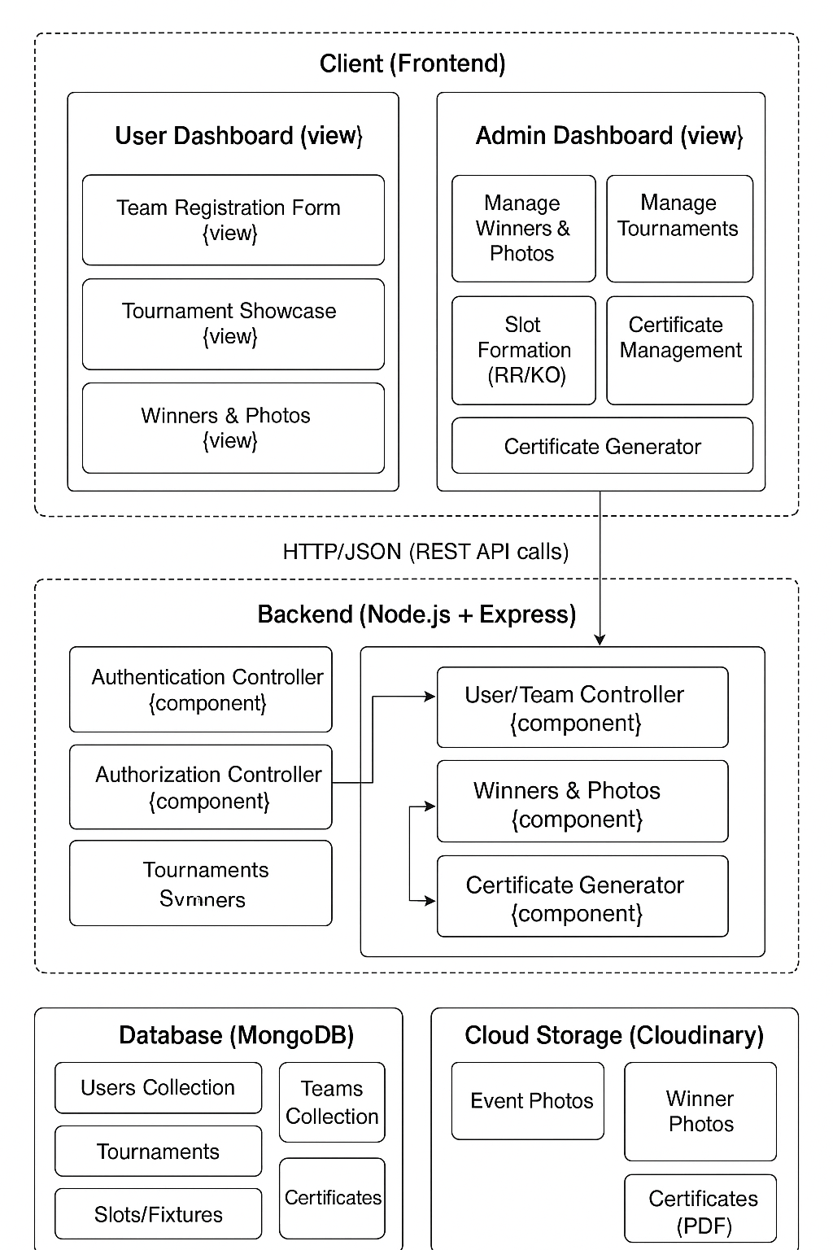
System Architecture

Slide 8
Clearly Defined Scope
The scope of the Sportify Campus project is well-defined and focused on solving specific problems within campus sports event management. The system’s main functionalities are clearly outlined:
1
2
3
Centralized Event Management
Participant Registration
Automated Slot Formation
Admins can create and manage events, including scheduling and venue assignment.
Seamless registration process for all events.
Generation of fair tournament slots using round-robin
or knockout algorithms, reducing manual bias and
errors.
4
5
Certificate Generation
Focused Exclusions
Automated generation of certificates for
participants.
The scope specifically excludes external event management and advanced analytics modules, ensuring a focused and manageable project.

Slide 9





Key Users & Stakeholders
Primary Users: Students
Primary Users: Coaches
Secondary Users: Event Organizers
Directly benefit from easy event registration, smart scheduling, and enhanced sports participation.
Streamlined team management, attendance tracking, and communication tools.
Efficient event creation, venue booking, and participant management for seamless execution.
Secondary Users: Sponsors
Primary Users: College Administration
Gain visibility and engagement opportunities through campus sports events.
Access to centralized data, reporting, and improved resource allocation.

Slide 10
Addressing Key Inefficiencies
The problem statement clearly identifies inefficiencies in manual campus sports event management. Sportify Campus aims to provide a centralized digital system to handle scheduling, participation management, result tracking, and certificate automation, all within the campus environment. This directly addresses the lack of a modern, integrated solution.
Manual Management
Lack of Centralization
Limited Scope
Inefficient processes for event organization.
No single digital system for sports events.
Focus on intra-campus events for targeted solution.

Slide 11


Resource Alignment
The project requirements are well-aligned with available software and hardware resources, ensuring feasibility and efficient development.
Software Stack
Hardware Needs
Frontend: React (Web/Mobile)
Standard campus server and cloud storage.
Backend: Node.js (REST APIs)
No special hardware (GPUs, advanced compute) required
Database: MongoDB
Certificate Engine: Puppeteer / wkhtmltopdf

Slide 12



Identified Project Risks
Comprehensive risk identification ensures proactive planning for potential challenges across technical, operational, schedule, and business domains.
Technical
Operational
Schedule & Business
Certificate generation scalability
Campus SSO integration challenges
Backend API development delays
Scheduling conflict algorithm design
Lack of backup during peak load
Low adoption due to usability
Data privacy risks

Slide 13


Risk Prioritization & Mitigation
High Priority Risks
Mitigation Strategies
Authentication Integration: Challenges with campus SSO integration.
Mock Authentication: Implement early mock SSO for parallel development.
Scheduling Conflicts: Complex algorithm for conflict prevention.
Rule-based Scheduling: Develop rule-based engine with conflict detection.
Certificate Errors: Inaccuracies or generation failures.
Batch Processing: Use asynchronous batch processing and validation.
Early Integration Testing: Conduct continuous integration testing from outset.

Slide 14
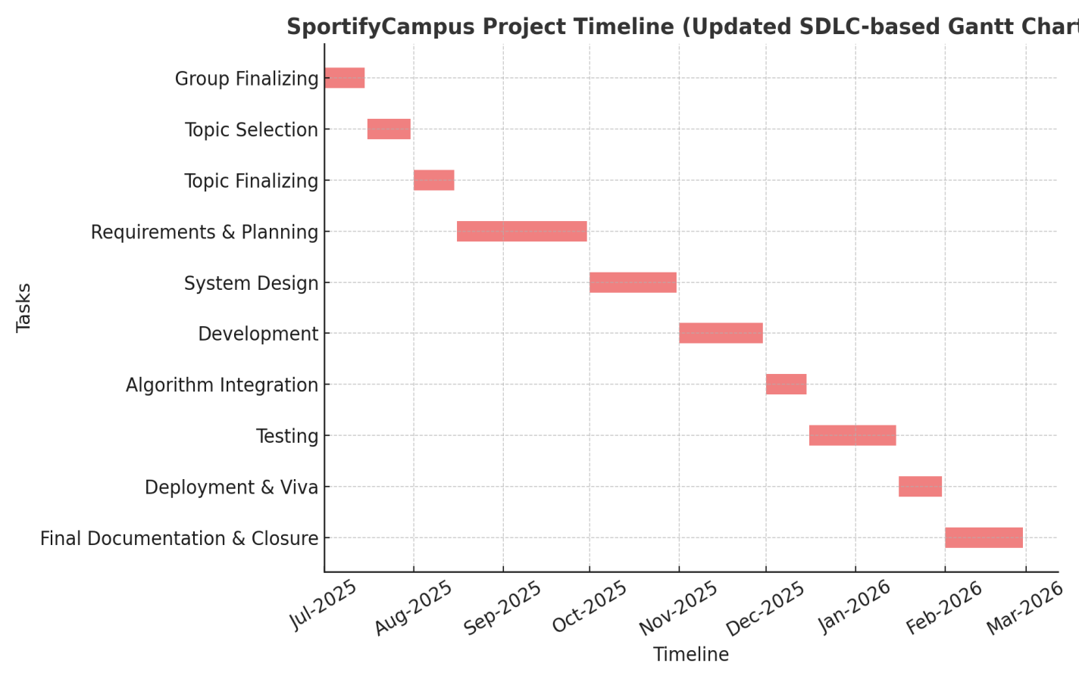
Time Line-

Slide 15
Requirement Analysis: Completeness, Consistency & Accuracy
Completeness
Consistency
Accuracy
User profiles (students (captains), admin)
Standardized data formats across all modules.
Validated data input for registrations.
Team registration and management
Clear definition of roles and permissions for users.
Precise time and slot management for events.
Event details (tournaments, matches, schedules)
Uniform handling of event states (upcoming, active, completed).
Real-time updates for tournament showcases.
Historical data (past winners, photo galleries)
Integration points (authentication, notifications, storage)

Slide 16
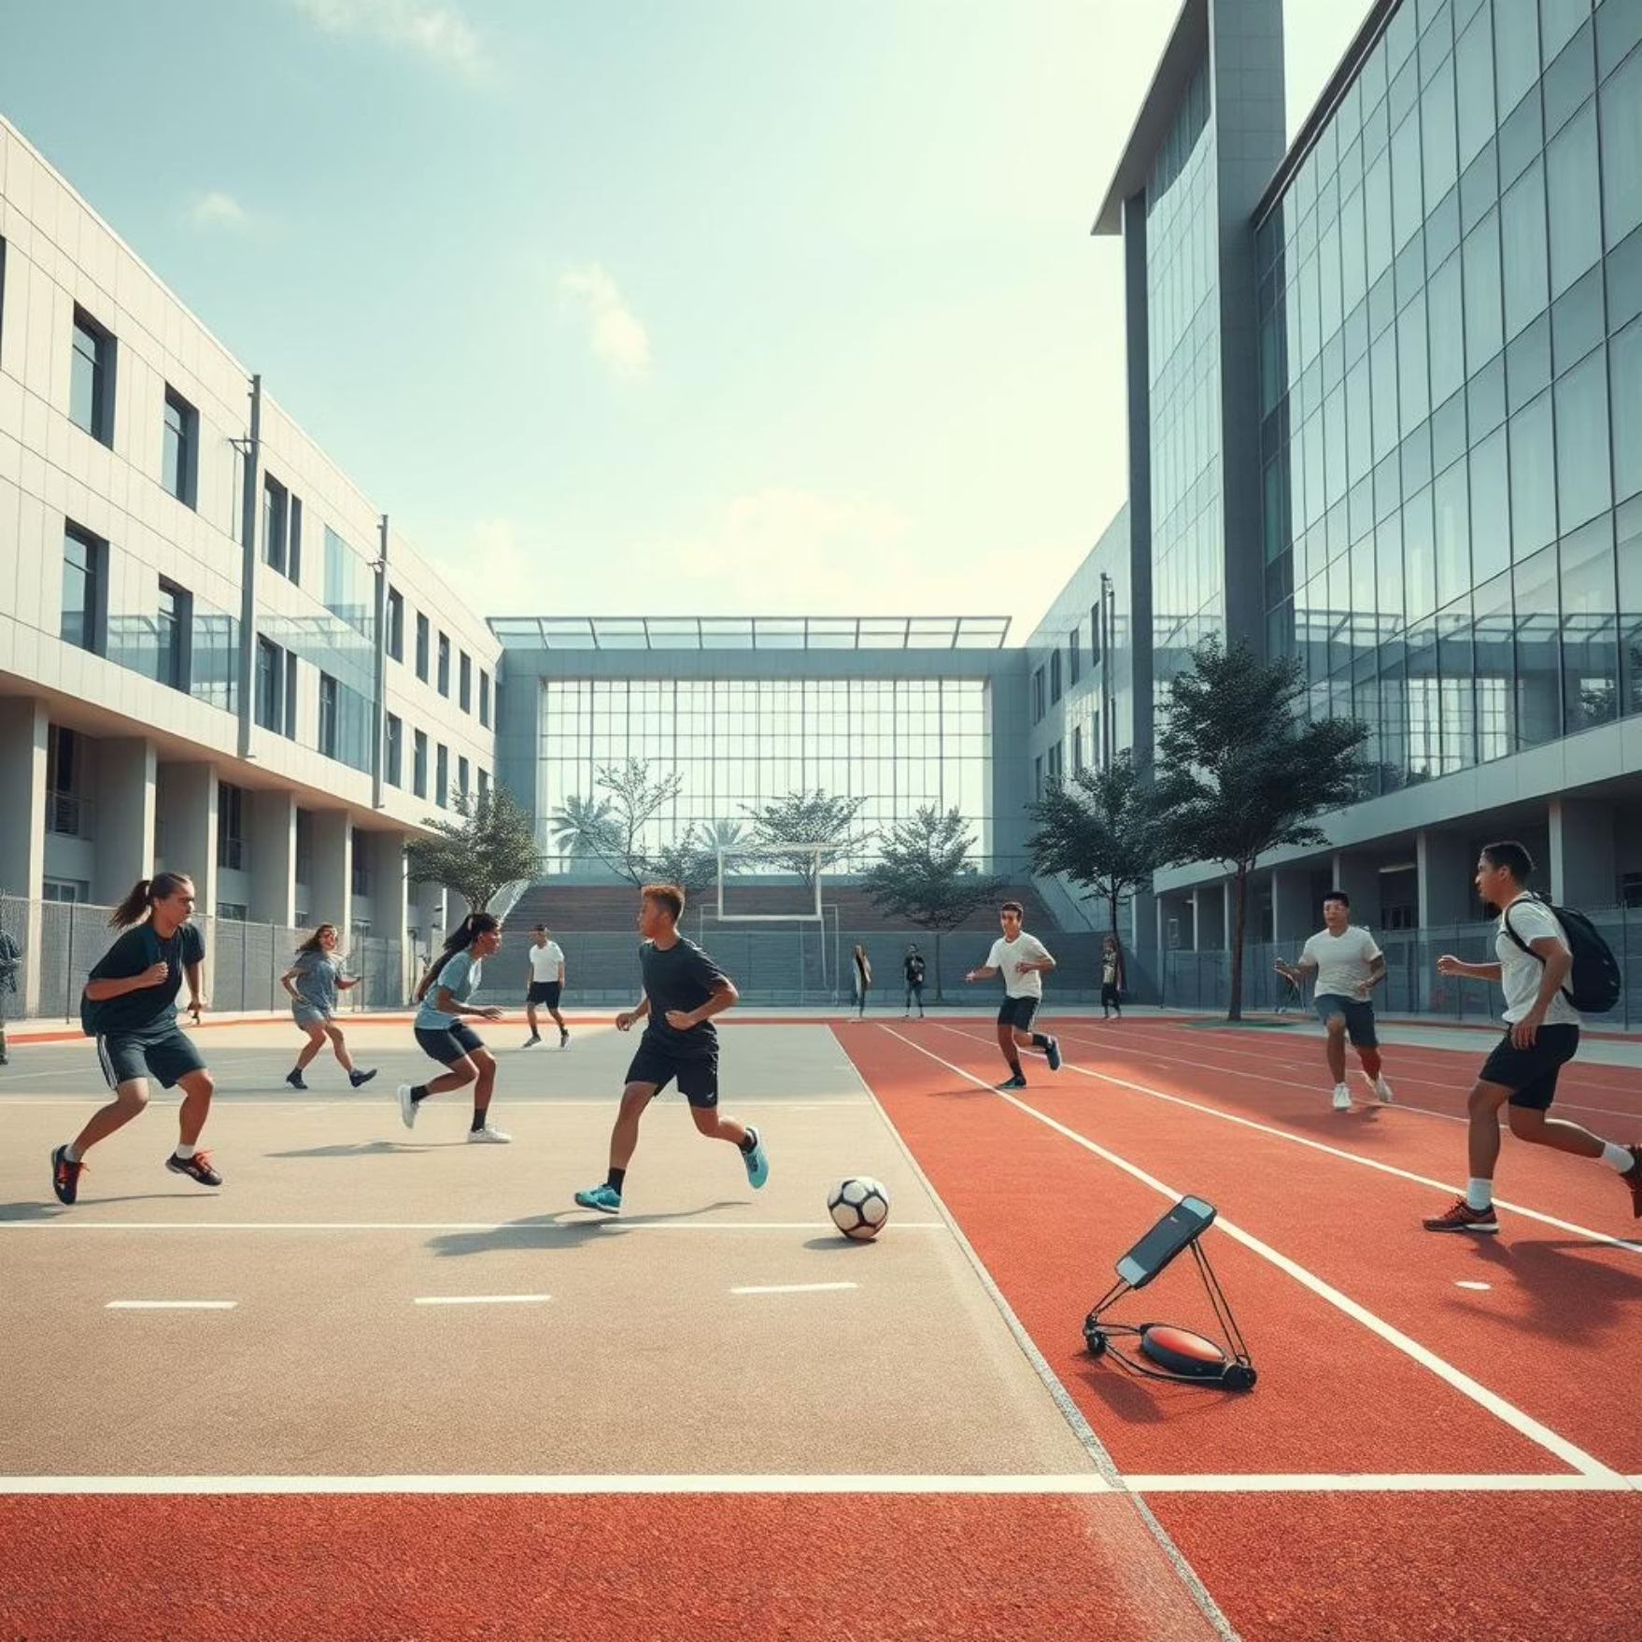
Resource, Budget, and Market Alignment
Consistency with Constraints
Schedule: Phased development focusing on core features first (MERN stack allows rapid prototyping).
Resources: Leveraging open-source technologies and MERN stack expertise within the team.
Budget: Minimal infrastructure costs due to cloud-native approach (e.g., MongoDB Atlas, Vercel/Netlify for deployment).
Market Need
High demand in educational institutions for efficient sports management solutions.
Improved engagement for students and faculty in campus sports.
Increased visibility for college sports events and achievements.
High demand in educational institutions for efficient sports management solutions.
Improved engagement for students and faculty in campus sports.
Increased visibility for college sports events and achievements.

Slide 17



Requirements Traceability & Documentation
System-Level Traceability
Comprehensive Documentation
Scope Adherence
Each user story/feature maps directly to architectural components.
Focused on core features (registration, scheduling, display).
Requirements Specification Document (RSD) detailing functional and non-functional requirements.
Future enhancements (e.g., live scoring, advanced analytics) are out of scope for current iteration.
E.g., "User Registration" traces to frontend forms, backend API endpoints, and database schema.
Scope clearly defined: college sports event management, MERN stack web app.
User stories, use cases, and acceptance criteria for each feature.

Slide 18
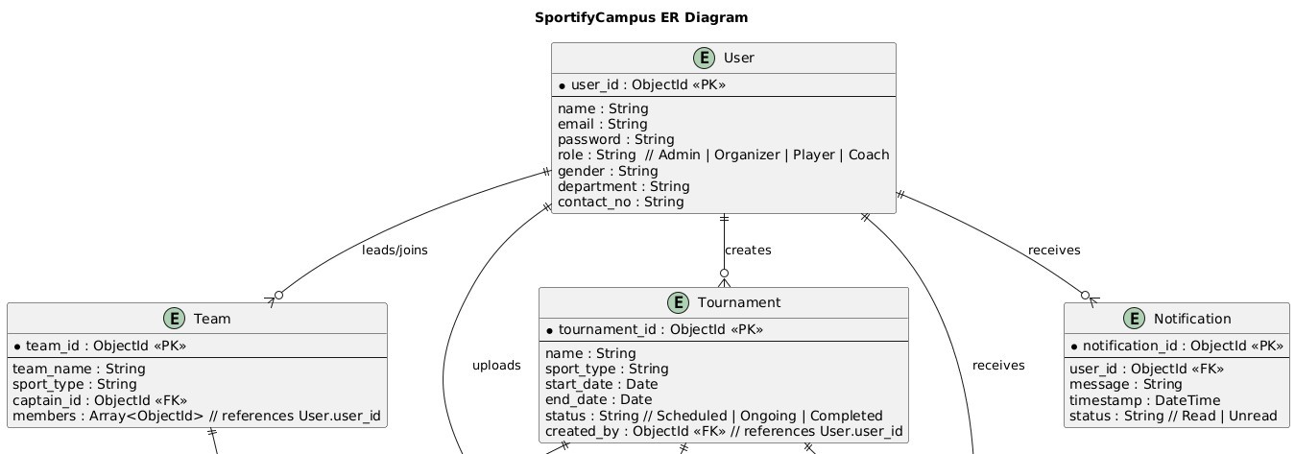
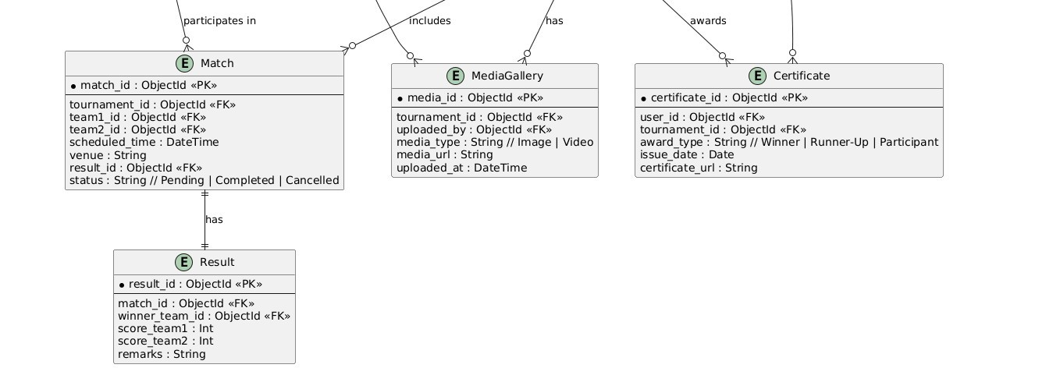
Analysis Classes & Architecture Reflection
Identified Analysis Classes
Architecture Reflection
Boundary Classes: User Interface components (LoginScreen, EventPage).
Frontend (React): Primarily boundary classes.
Entity Classes: Core data objects (User, Team, Event, Tournament, Winner).
Backend (Node.js/Express): Control classes (API routes, business logic).
Control Classes: Orchestration logic (RegistrationController, SchedulingManager, AuthController).
Database (MongoDB): Entity classes (data models/schemas).

Slide 19



Modularity & Design Adherence
Design Addressing Issues
Effective Modularity
Functional Independence
Design directly tackles manual processes with automation, fragmented data with a centralized database, and poor UX with an intuitive interface.
Frontend: Component-based React architecture (User, Team, Event components).
Modules interact via well-defined APIs. Changes in one module have minimal impact on others (e.g., authentication module can be updated without affecting event scheduling logic).
Backend: Microservice like structure for APIs (UserAuth, EventManagement, ContentManagement).

Slide 20
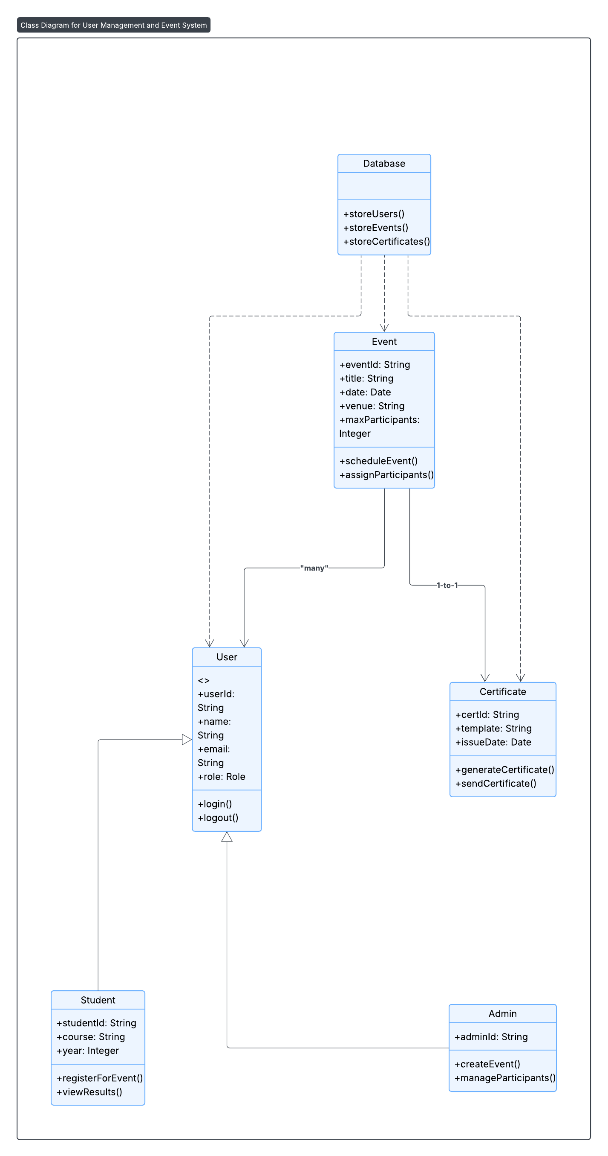
Structural Diagrams: Clarity & UML Compliance
Class Diagram Clarity
Each class (e.g., User, Event, Student) represents a distinct entity in the system architecture.
Associations (e.g., User registers for Event) are explicitly defined with roles and multiplicity.
Services provided by classes (e.g., Event.scheduleEvent(), User.login()) are clear.
UML Standard Compliance
Standard UML notation used for classes, attributes, methods, associations, and multiplicity.
Multiplicities (e.g., 1..*, 0..1) from use cases are accurately translated to class relationships.

Slide 21
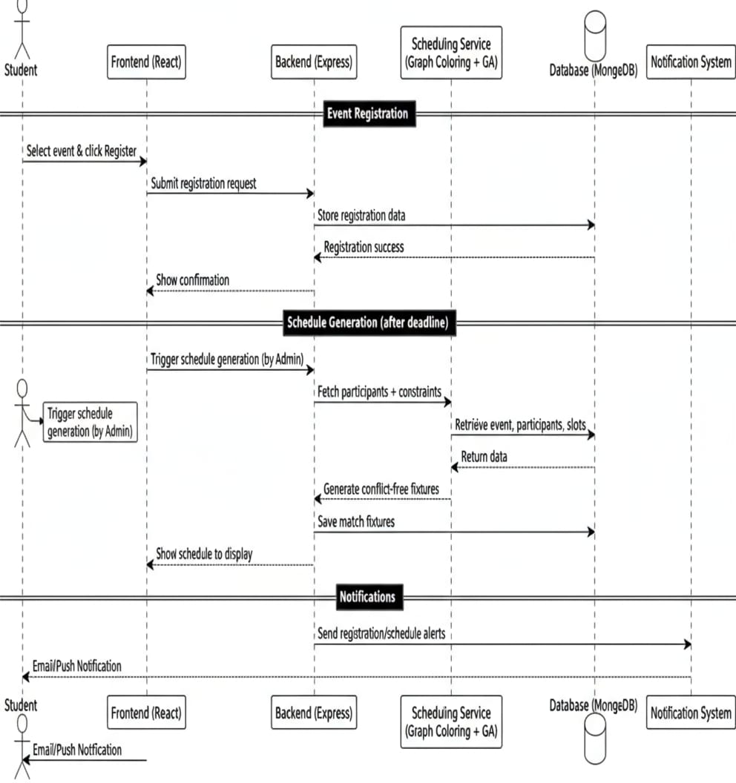
Sequence Diagram
This sequence diagram outlines the key interactions within Sportify Campus involving students, administrators, and core system modules: frontend, backend, scheduling service, database, and notification system.

Slide 22
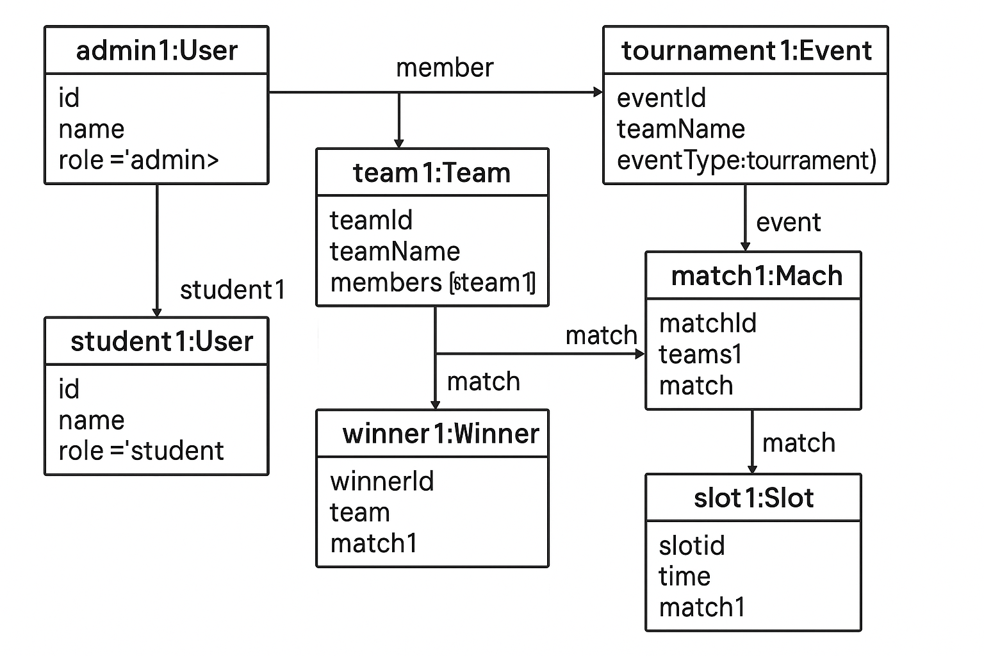
Structural Diagrams: Clarity & UML Compliance
Object Diagram Clarity
Objects (e.g., User, Event, Team) are clearly labeled and represent specific instances of classes.
Associations are shown as object-level links, with roles if needed.
The diagram provides a realistic snapshot of the system at a specific point in time.
UML Standard Compliance
Standard UML notation used for classes, attributes, methods, associations, and multiplicity.
Multiplicities (e.g., 1..*, 0..1) from use cases are accurately translated to class relationships.

Slide 23
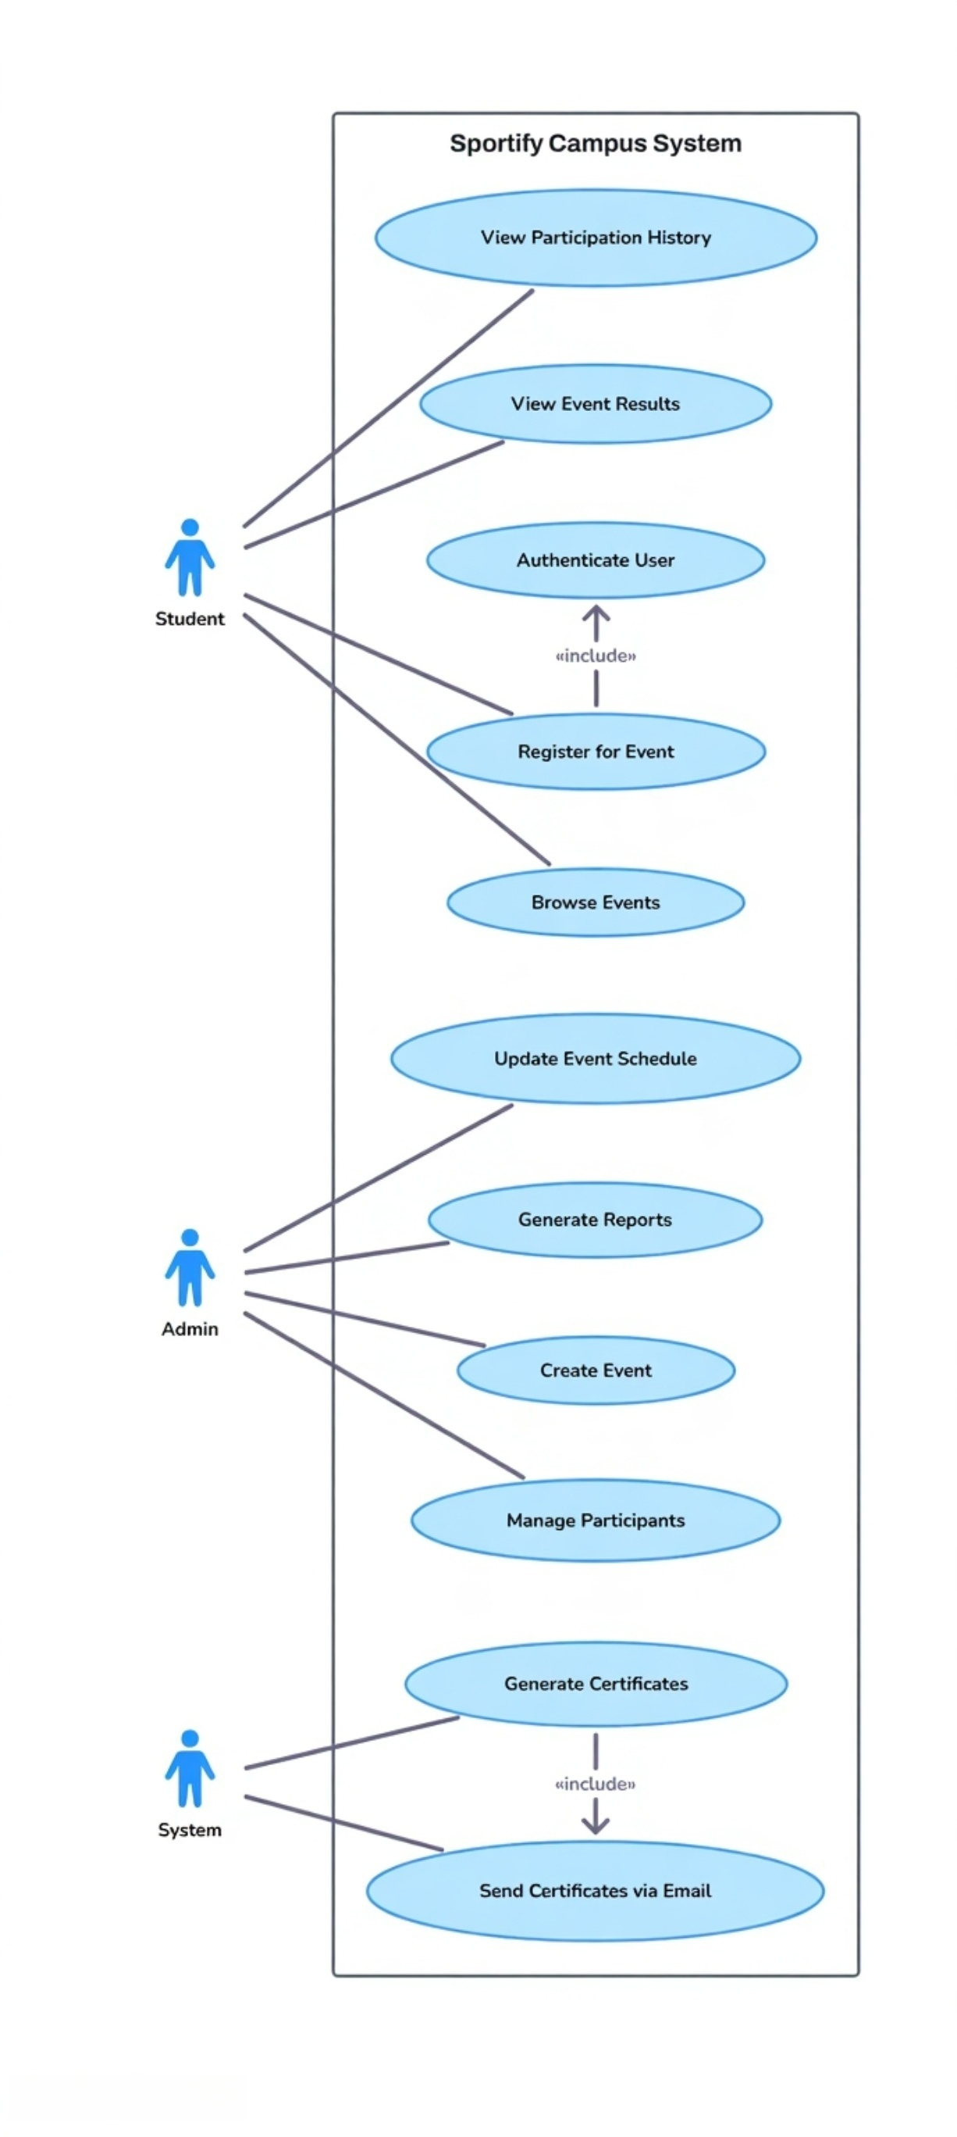
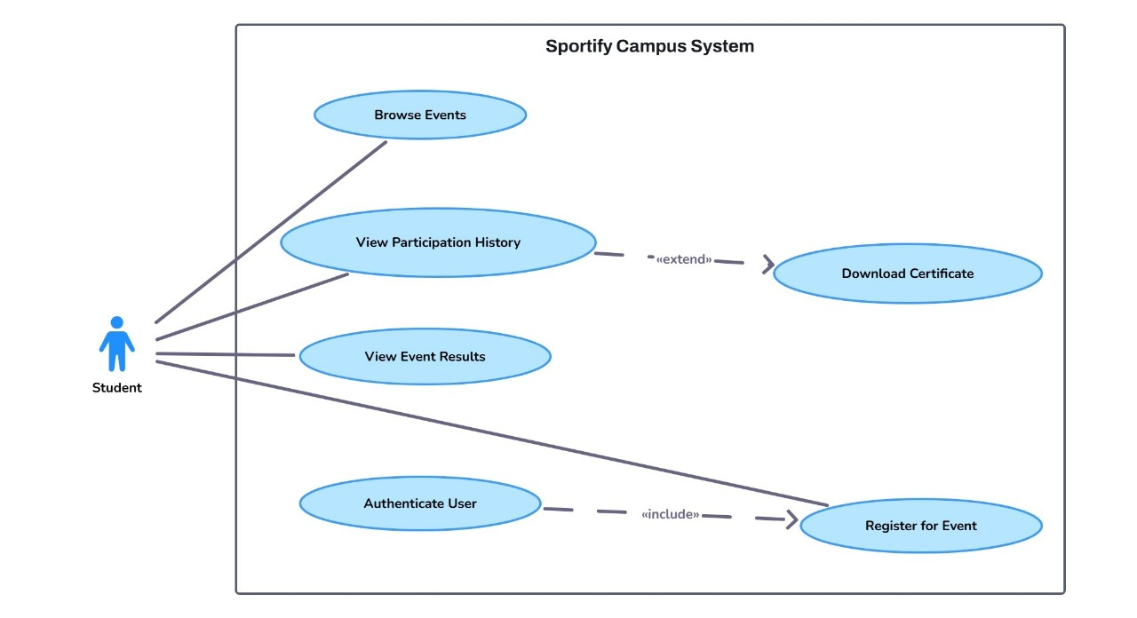
Behavioral Diagrams: Definition & Consistency
Use Case Diagram
Actors: Student, Admin, System.
Input/Output: Clearly defined for each use case (e.g., "Register for Event" has student input, system confirmation output).
Activity & State Chart Diagrams
Activity Diagrams: Illustrate workflows (e.g., "Event Creation Process").
State Charts: Correctly model dynamic behavior of key entities (e.g., Event states: Planned > Active > Completed > Archived).

Slide 24
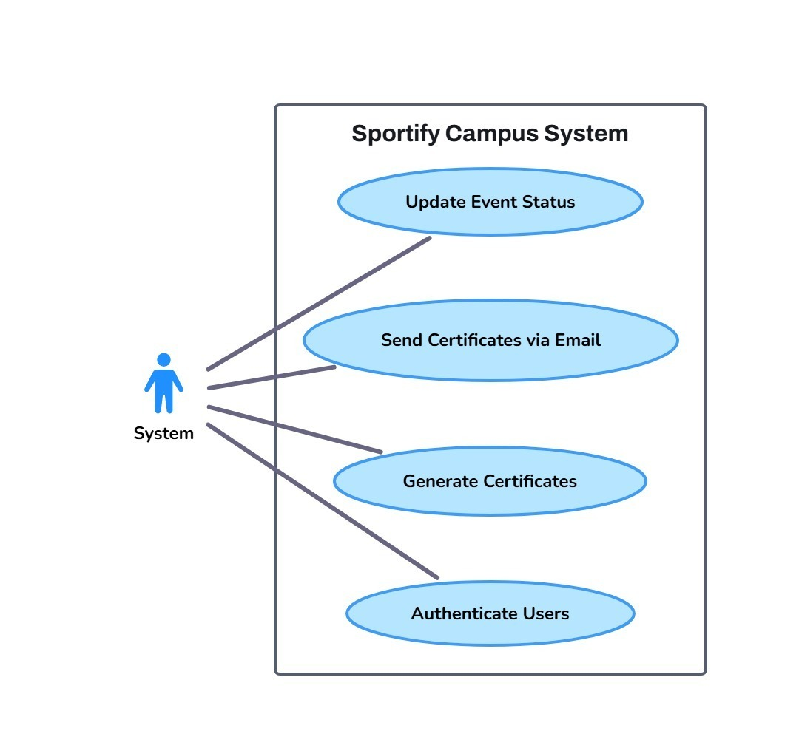
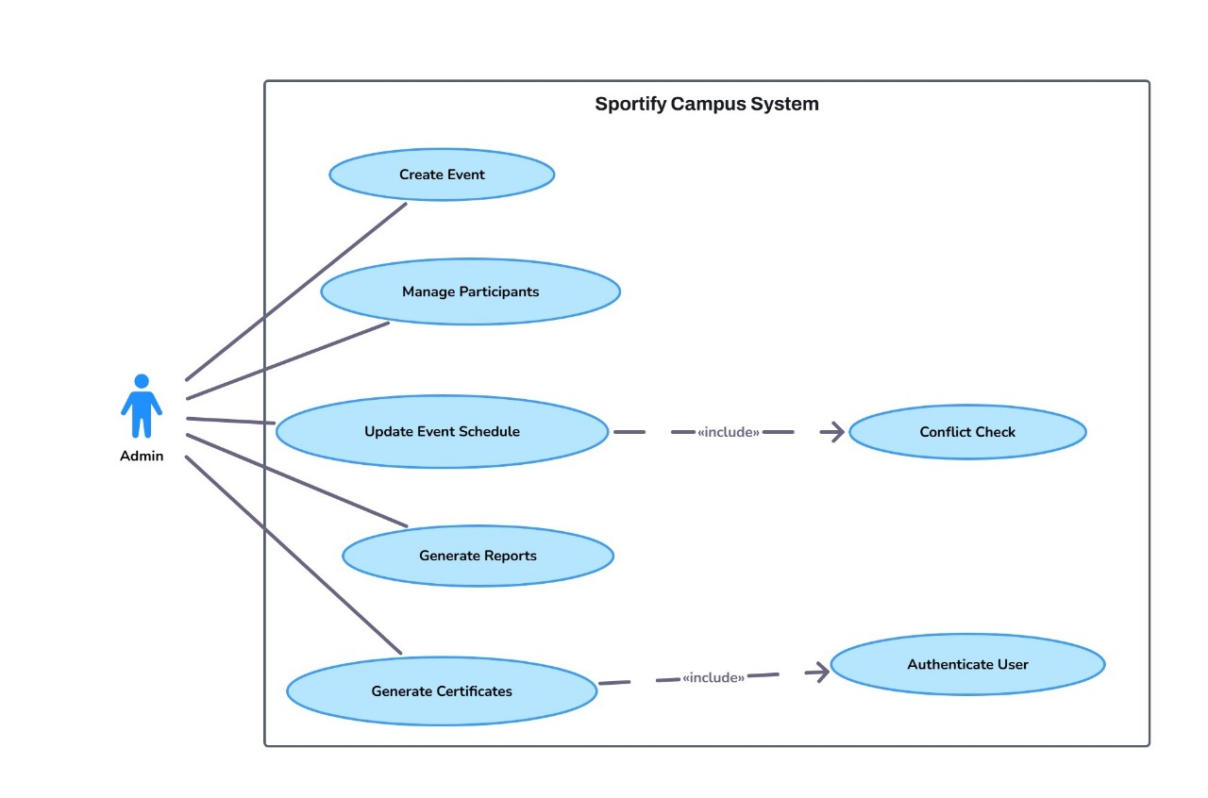
Behavioral Diagrams: Definition & Consistency
Use Case Diagram
Activity & State Chart Diagrams
Activity Diagrams: Illustrate workflows (e.g., "Event Creation Process").
State Charts: Correctly model dynamic behavior of key entities (e.g., Event states: Planned > Active > Completed > Archived).

Slide 25
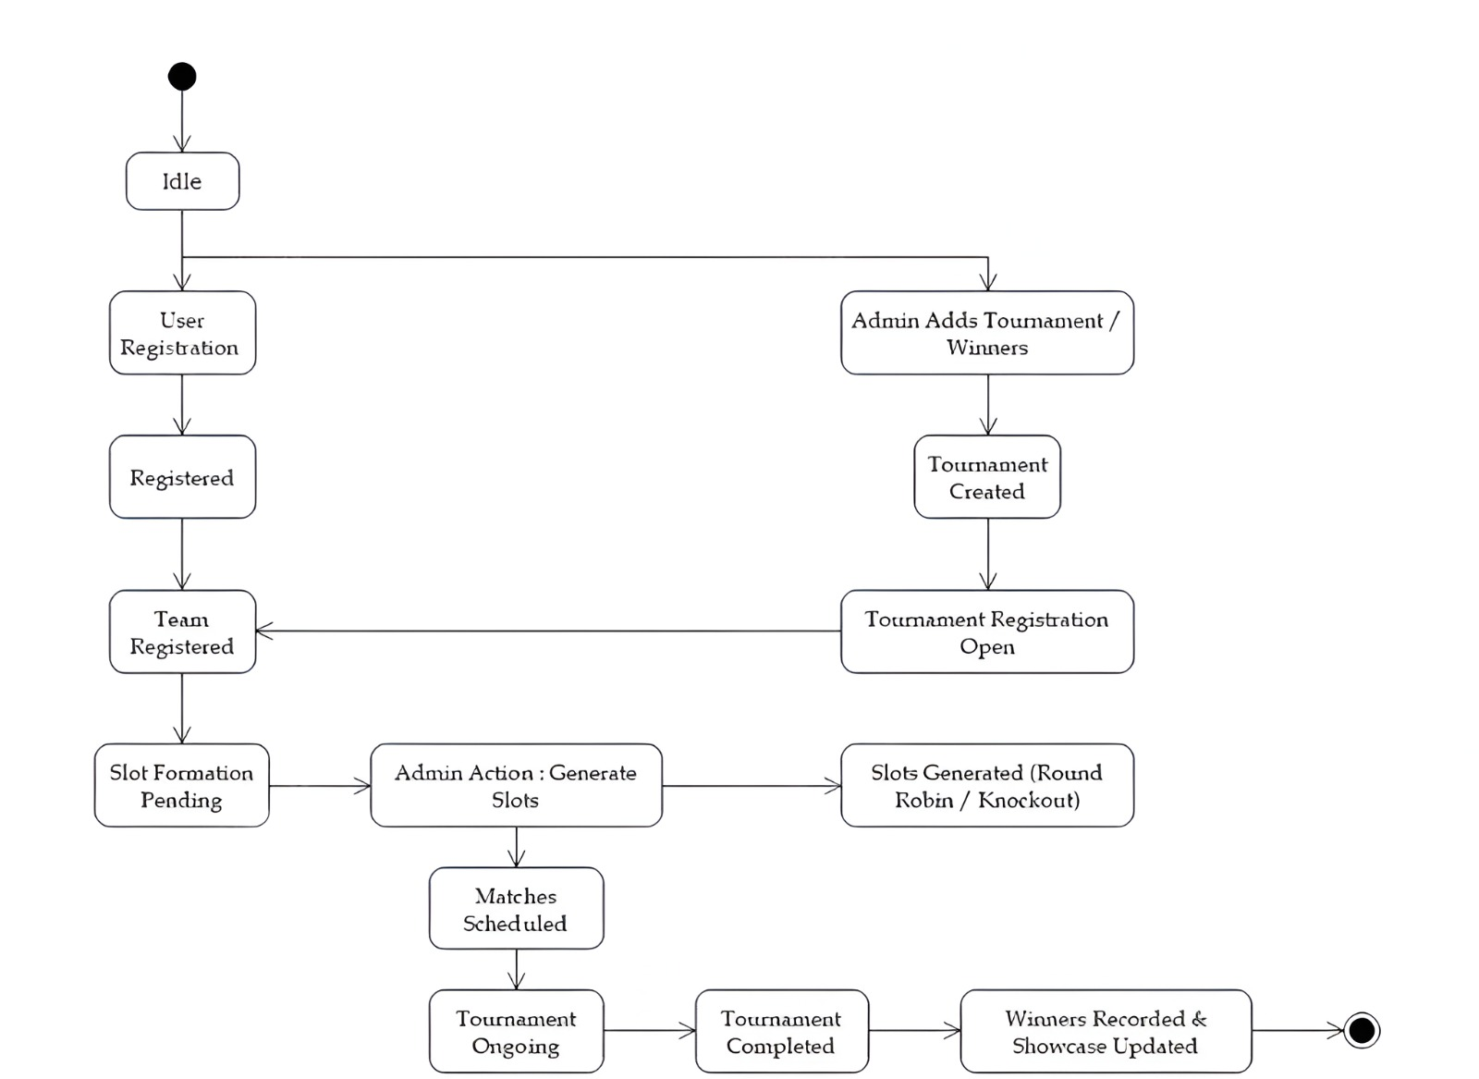
Behavioral Diagrams: Definition & Consistency
State Diagram
Actors: Student, Admin.
Input/Output: Clearly defined for each use case (e.g., "Register for Event" has student input, system confirmation output).
Activity & State Chart Diagrams
Activity Diagrams: Illustrate workflows (e.g., "Event Creation Process").
State Charts: Correctly model dynamic behavior of key entities (e.g., Event states: Planned > Active > Completed > Archived).

Slide 26
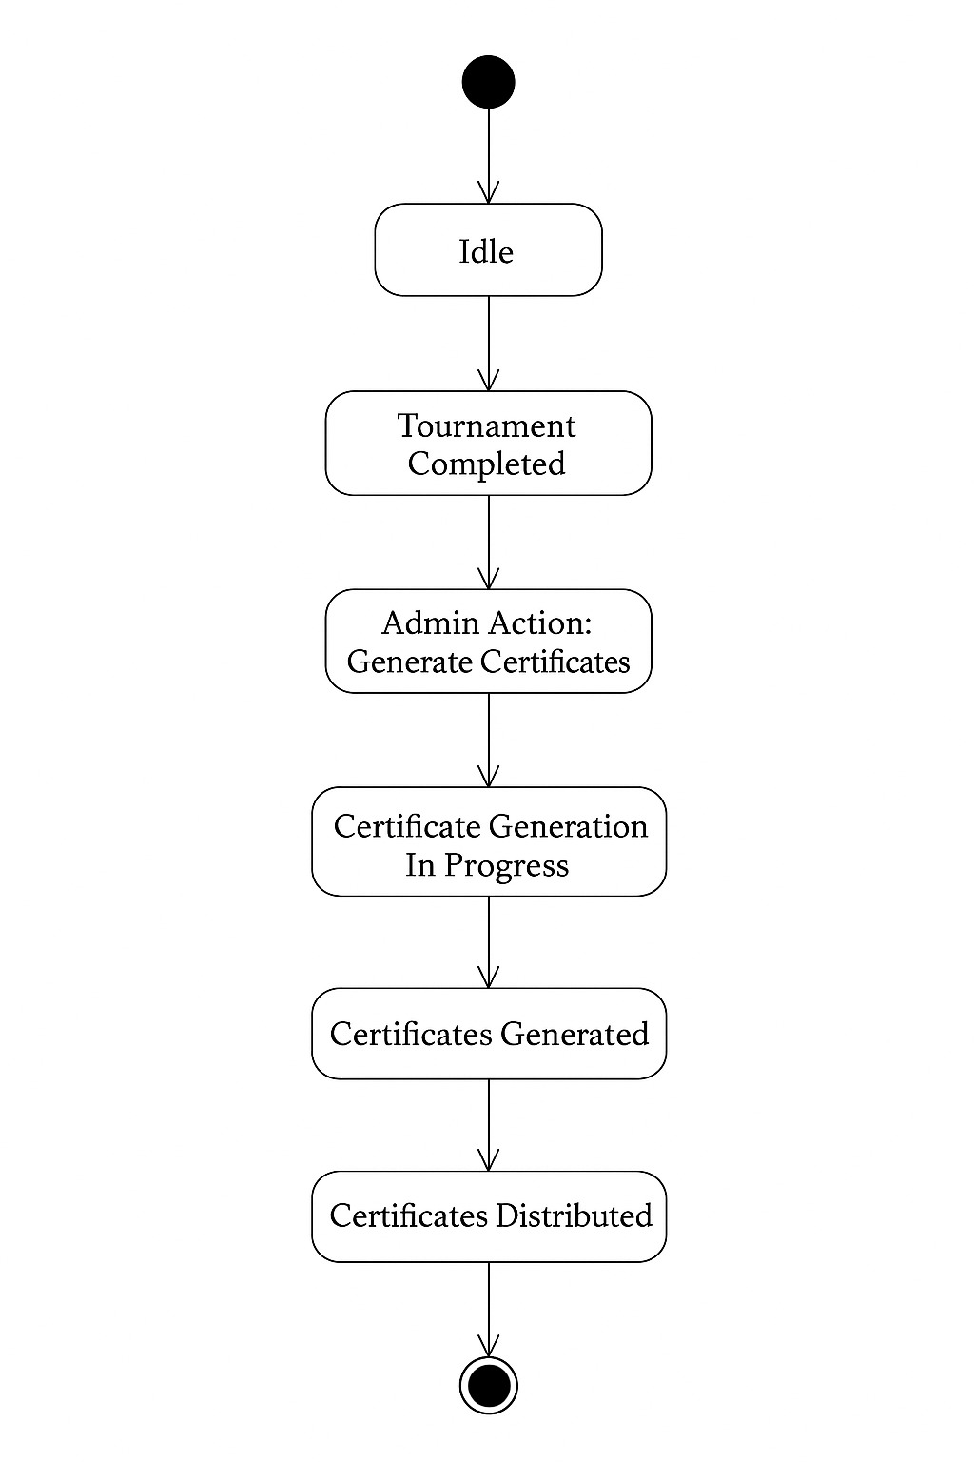
Behavioral Diagrams: Definition & Consistency
State Diagram
Actors: Student, Admin.
Input/Output: Clearly defined for each use case (e.g., "Register for Event" has student input, system confirmation output).
Activity & State Chart Diagrams
Activity Diagrams: Illustrate workflows (e.g., "Event Creation Process").
State Charts: Correctly model dynamic behavior of key entities (e.g., Event states: Planned > Active > Completed > Archived).

Slide 27
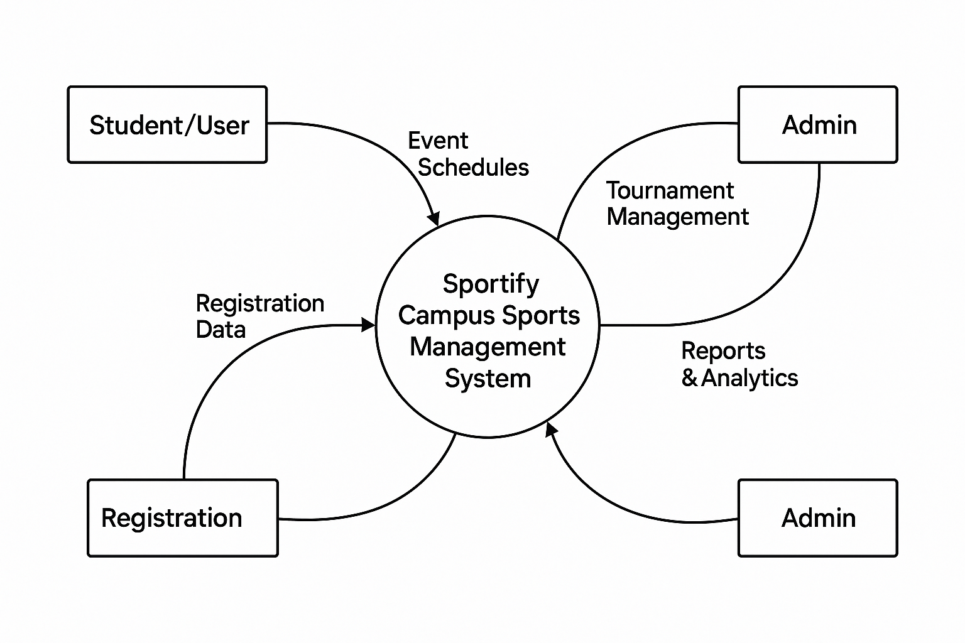
Data Flow Diagram
DFD Level 0
The Context Diagram represents the highest level view of the Sportify Campus, showing the system as a single process interacting with external entities.
External Entities : 1) Student/User 2) Admin/Coordinator.
Activity & State Chart Diagrams
Activity Diagrams: Illustrate workflows (e.g., "Event Creation Process").
State Charts: Correctly model dynamic behavior of key entities (e.g., Event states: Planned > Active > Completed > Archived).

Slide 28
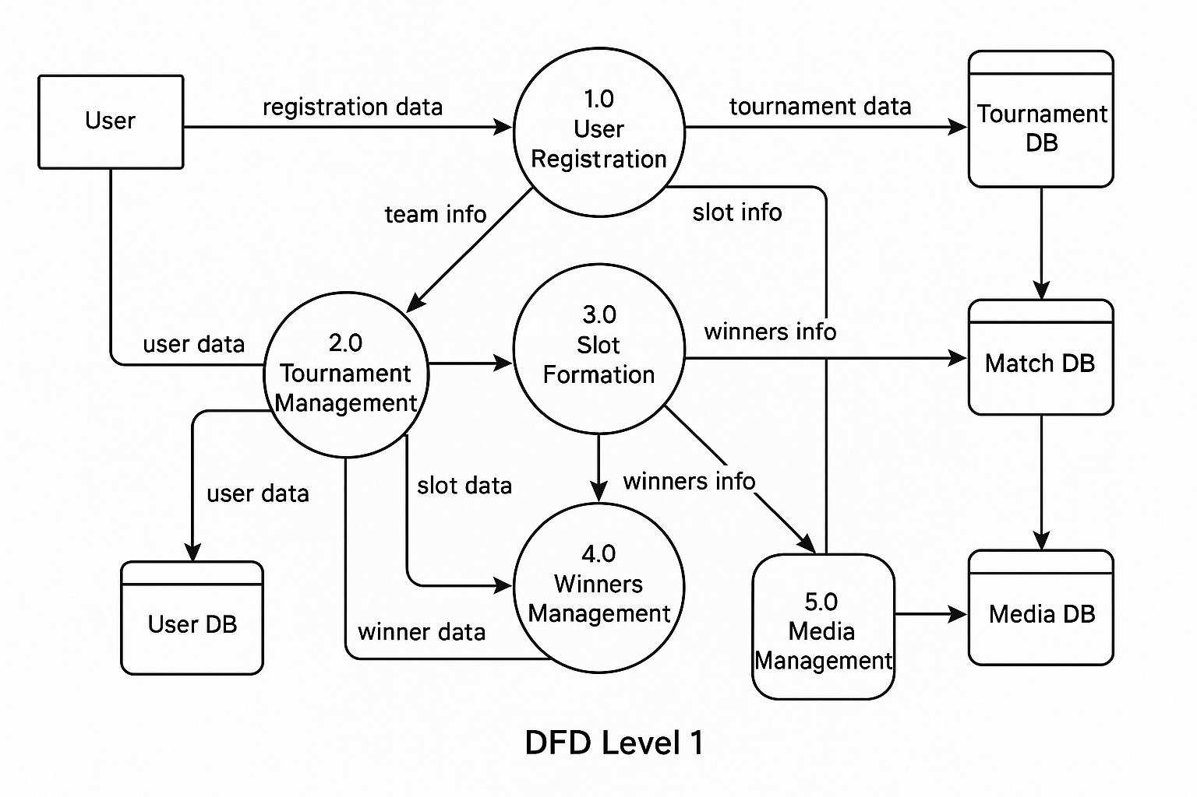
Data Flow Diagram
DFD Level 1
The Level 1 DFD decomposes the main system into primary functional processes, showing how data flows between major system
components and data stores.
Activity & State Chart Diagrams
Activity Diagrams: Illustrate workflows (e.g., "Event Creation Process").
State Charts: Correctly model dynamic behavior of key entities (e.g., Event states: Planned > Active > Completed > Archived).

Slide 29
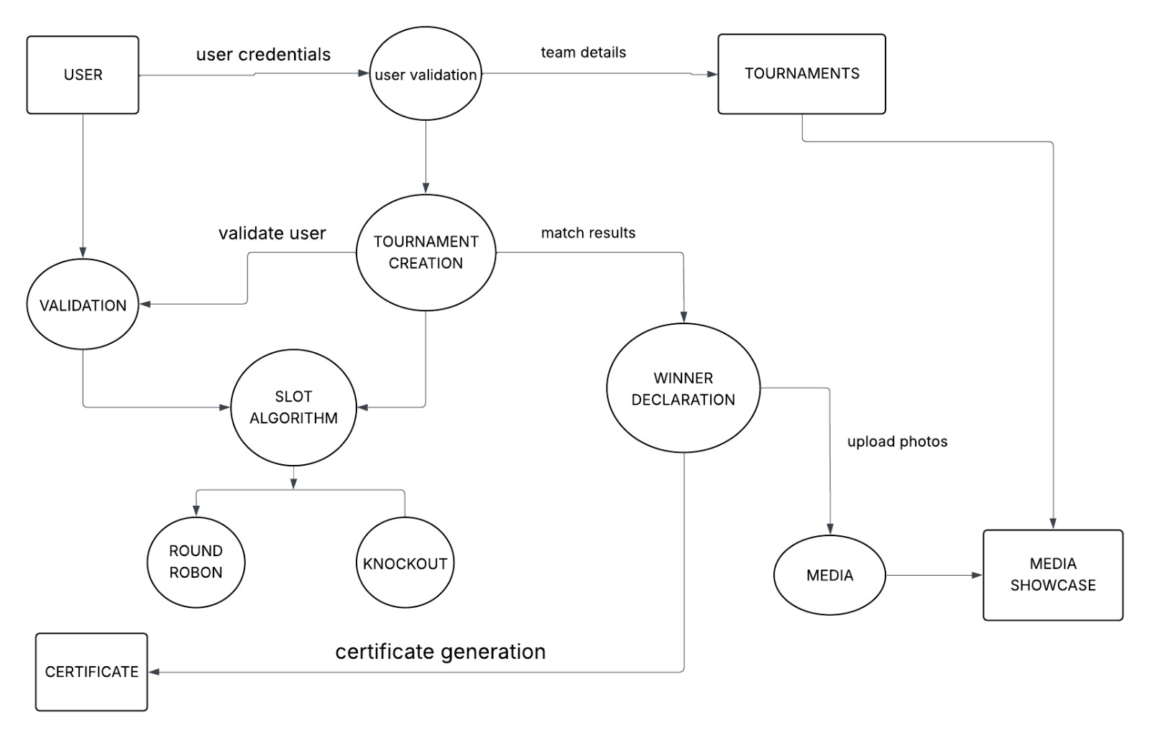
Data Flow Diagram
DFD Level 2
The Level 2 DFD provides detailed decomposition of Level 1 processes, showing internal sub-processes and their specific data transformations.
Activity & State Chart Diagrams
Activity Diagrams: Illustrate workflows (e.g., "Event Creation Process").
State Charts: Correctly model dynamic behavior of key entities (e.g., Event states: Planned > Active > Completed > Archived).

Slide 30
THANK YOU

